Slide 1

Problem
Managing one hospital is challenging; managing three hospitals in different locations is even harder
Key questions:
How to get an accurate picture of each hospital’s performance?
How to evaluate hospitals fairly and identify improvement opportunities?
Notes:
"إدارة مستشفى واحدة فيها أقسام مختلفة وموظفين متنوعين تعتبر تحدي كبير لأي مدير. دلوقتي ، تخيلوا معايا أن نفس الإدارة مسؤولة عن ثلاثة 3 فروع مستشفيات في مواقع مختلفة، وكل مستشفى ليها أسلوب إدارة وطرق تشغيل مختلفة.هنا السؤال المهم: ازاي ممكن للمدير أن يكون صورة دقيقة وموثوقة عن أداء كل مستشفى؟ وازاي ممكن يقييم الفروع بشكل عادل لاكتشاف فرص التطوير وزيادة كفاءة النظام ككل؟"

Slide 2

Hospital Performance Analytics & Appointment Completion Prediction
Cognitia
Notes:
الحل اللي قدمناه في المشروع بتاعنا : 🏥 Hospital Performance Analytics & Appointment Completion Predictionواللي فيه قدرنا نبني داشبورد تفاعلي يقدر المدير من خلاله انه يتابع أداء المستشفى بسهولة، سواء على مستوى:المالية (Finance)أداء الأطباءمدة بقاء المرضى في المستشفىبالإضافة، بنينا (Machine Learning) يقدر يتنبأ ب appointment هتكتمل او لا ، و اللي هيساعد على تحسين كفاءة النظام بشكل عام.

Slide 3





Team
Samaa Mwafi
Samar Mohamed
Quality Specialist at Ministry of Health and Population
Medical Coordinator at Dakahlia Health Directorate
Eng. Amr Ayyad
Supervisor
Shimaa El-Metwally
Esraa Allam
Computer Engineering Graduate & TA
Biotechnologist &
PPT Designer

Slide 4
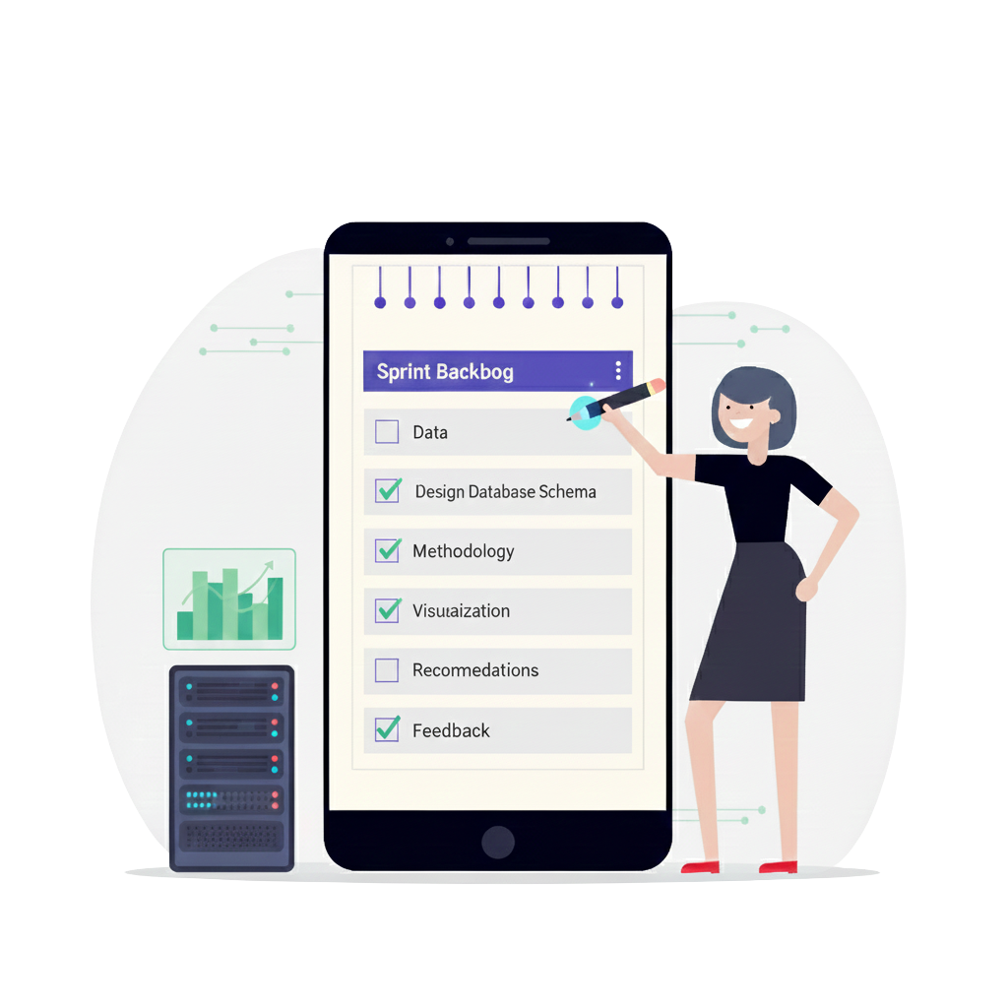

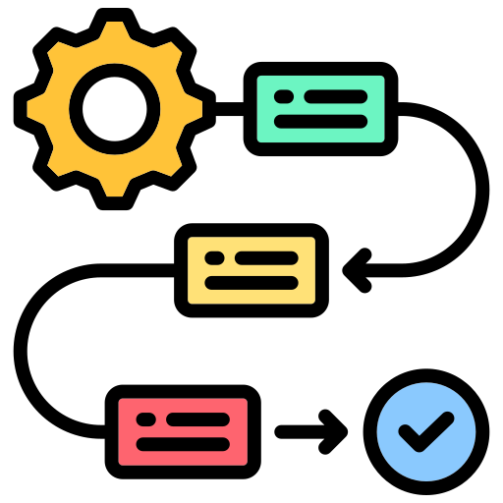




Agenda
Objectives
Methodology
Visualization
Recommendations
Machine learning

Slide 5





Objectives
Monitoring financial performance
Evaluating operational efficiency
Understanding doctor performance
Tracking treatment insights
Comparing performance between different hospital branches

Slide 6
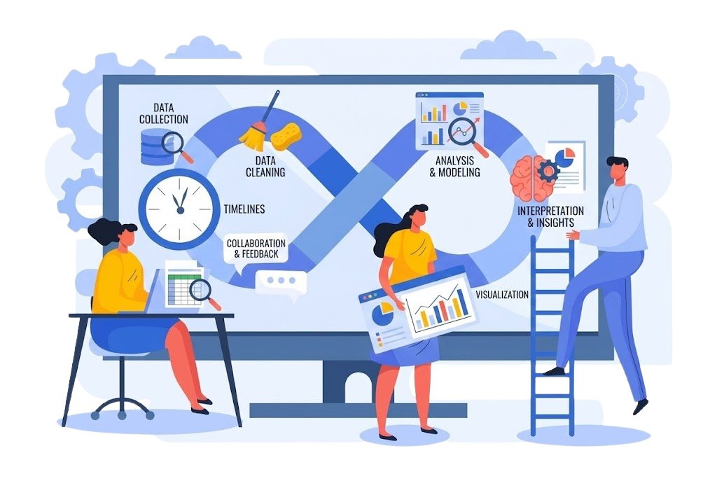





Methodology

Slide 7

Methodology
Collecting Data using Kaggle

Slide 8
Methodology
Collecting Data using Kaggle

Slide 9
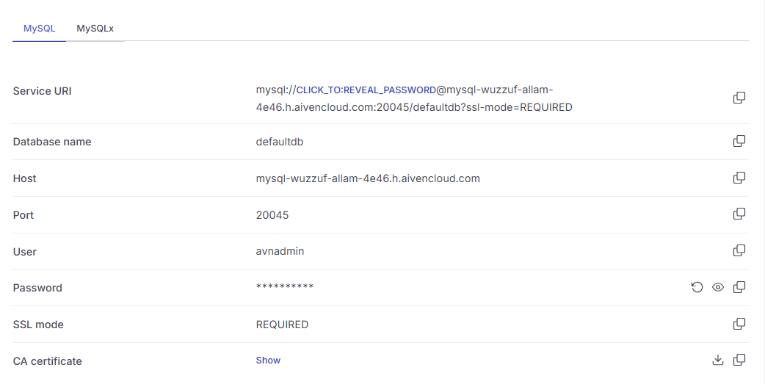

Methodology
Collecting Data using Kaggle

Slide 10
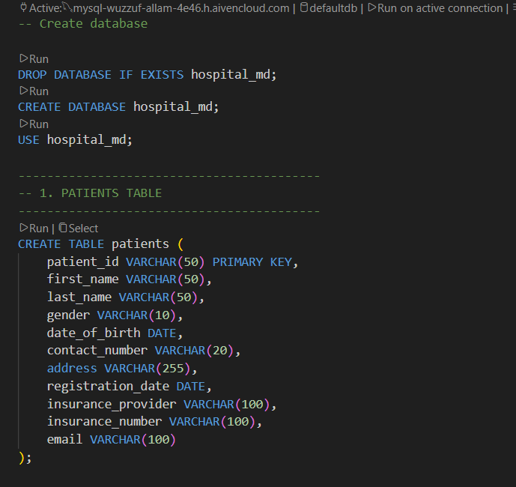
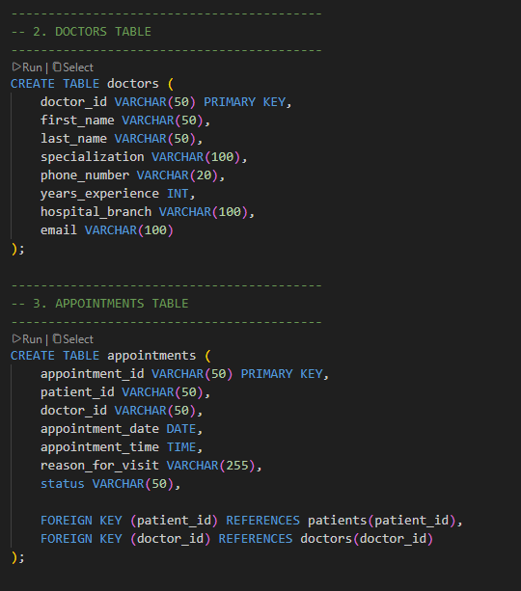
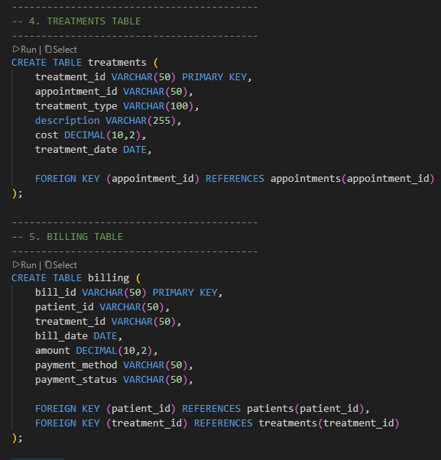
Methodology
Creating database using MySQL

Slide 11
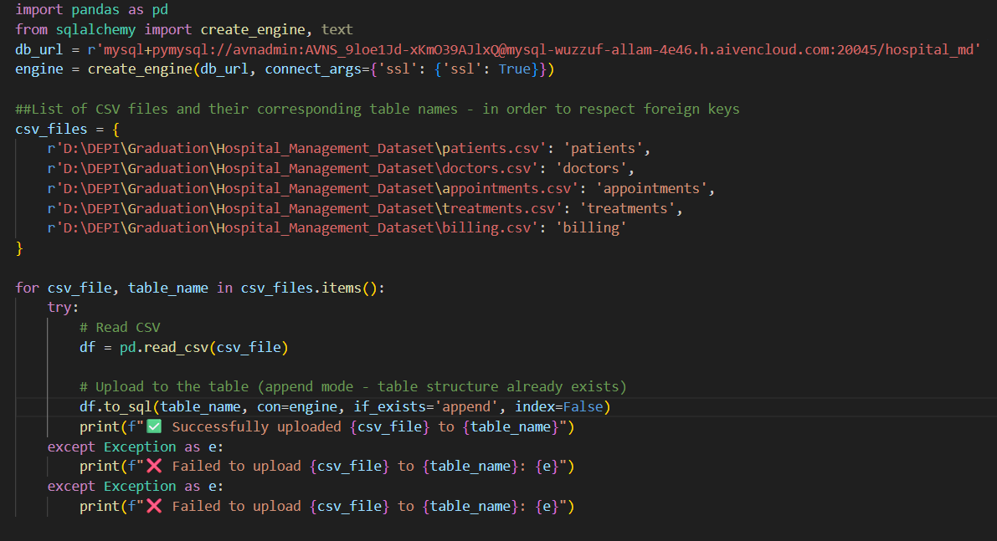
Methodology
Uploading Data to the Server

Slide 12






Methodology
Cleaning data
Appointments
Billing
Doctors
Patients
Treatments

Slide 13
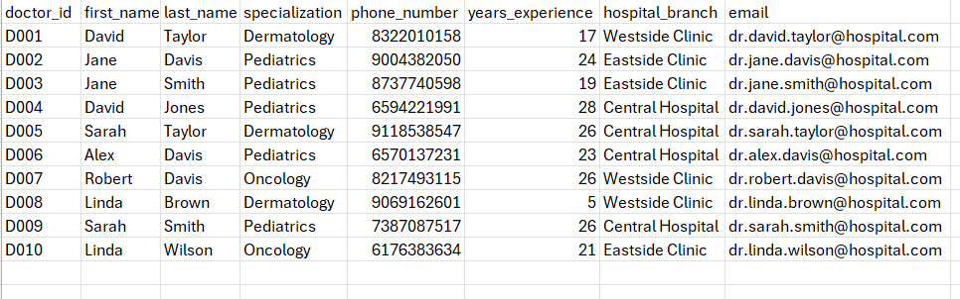
Methodology
Cleaning data
Doctors
Dropped the phone_number and email columns as they were not relevant to the analysis.

Slide 14
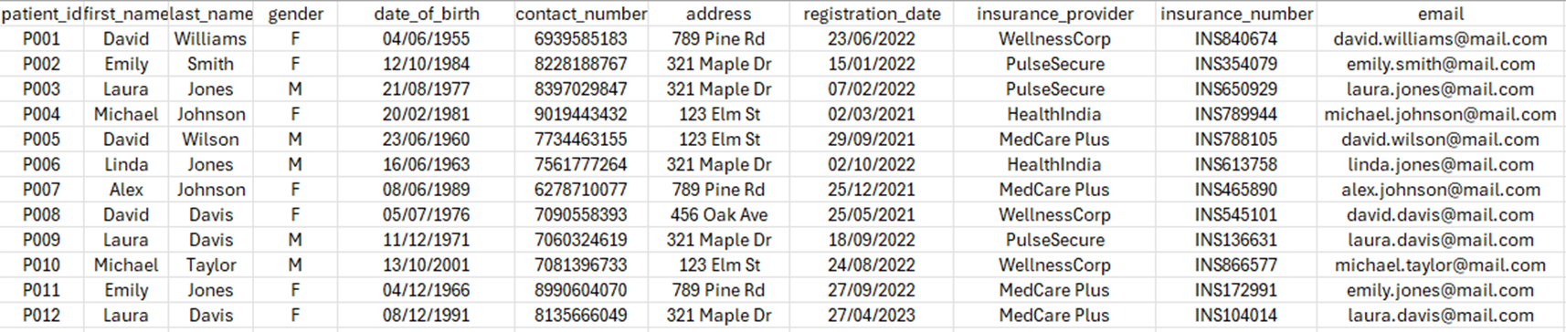
Methodology
Cleaning data
Patients
Dropped the date_of_birth, address, Insurance_nember and email columns as they were not relevant to the analysis.

Slide 15
Methodology
Cleaning data
◁▷
◁
Appointments
Billing
Doctors
Patients
Treatments
patient_id
patient_id
Patient_id
Appointment_id
Appointment_id
doctor_id
◁
◁
◁▷
◁▷
treatment_id
doctor_id
treatment_id

Slide 16


Slide 17

Recommendations
To improve the overall financial stability :
Speed up pending payments by streamlining insurer approvals and internal coordination.
To help smooth the monthly curve and reduce revenue drops :
Run targeted campaigns during low-volume months to maintain patient flow.
To help smooth the monthly curve and reduce revenue drops :
Run targeted campaigns during low-volume months to maintain patient flow.
For the cancellation and no shows :
• Enhance patient engagement through reminders, confirmations, and easy rescheduling.

Slide 18

Machine learning
A predictive machine learning model that estimates whether a patient will complete their appointment, helping hospitals reduce no-show rates and improve service quality.

Slide 19
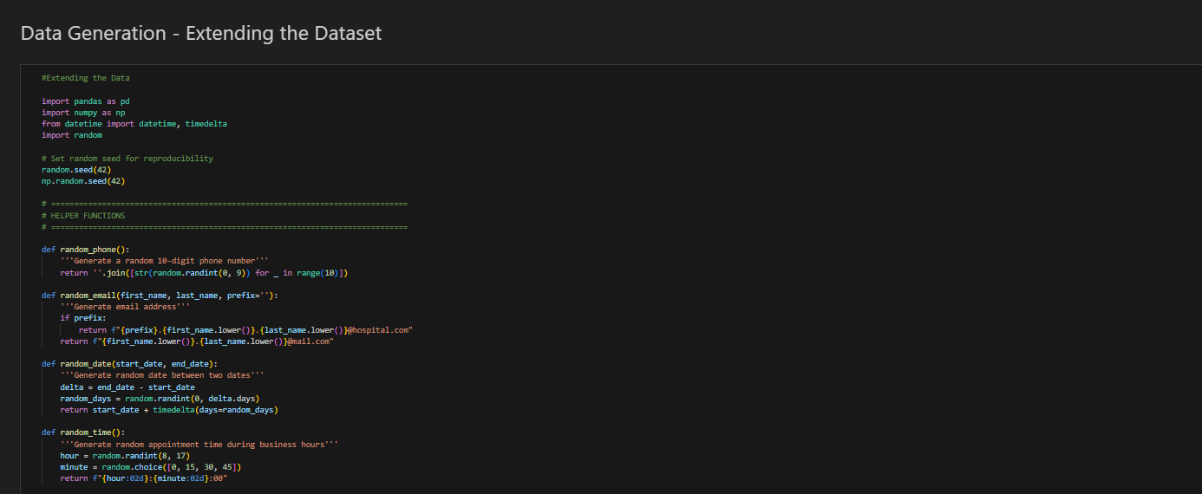
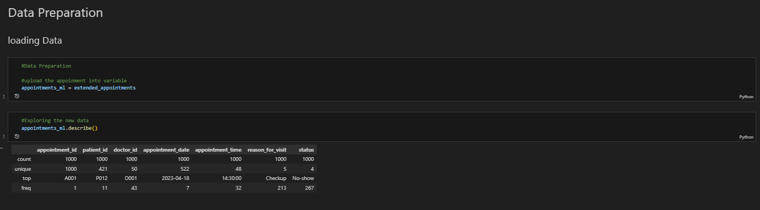
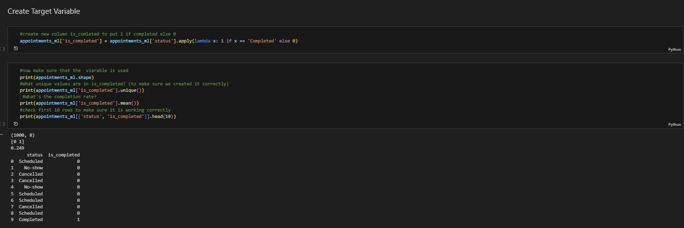
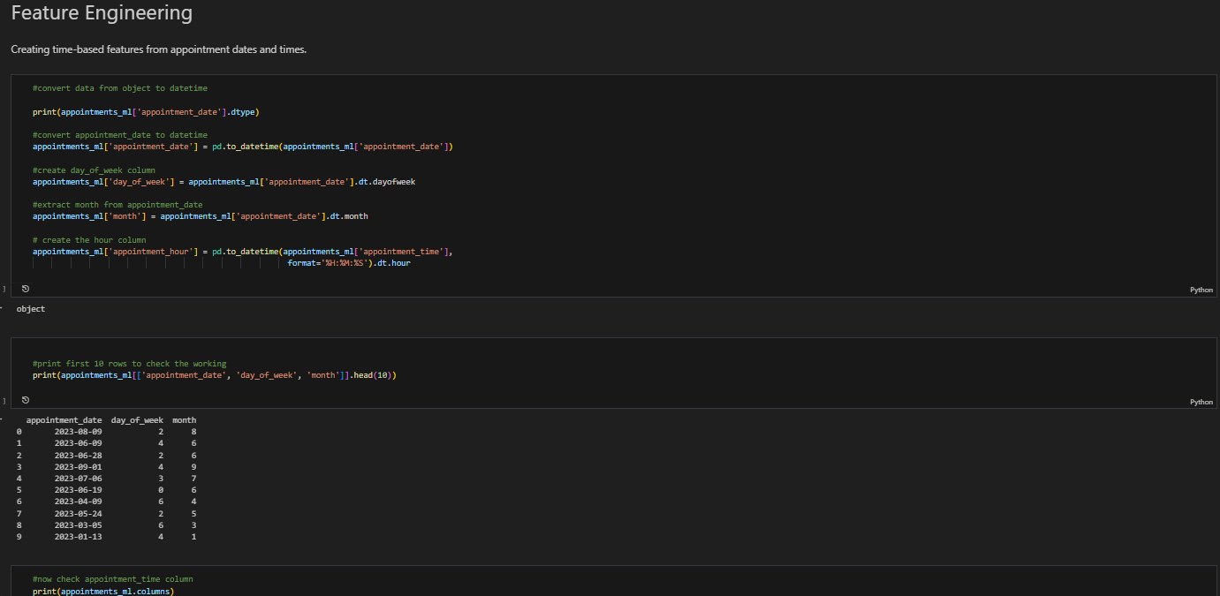
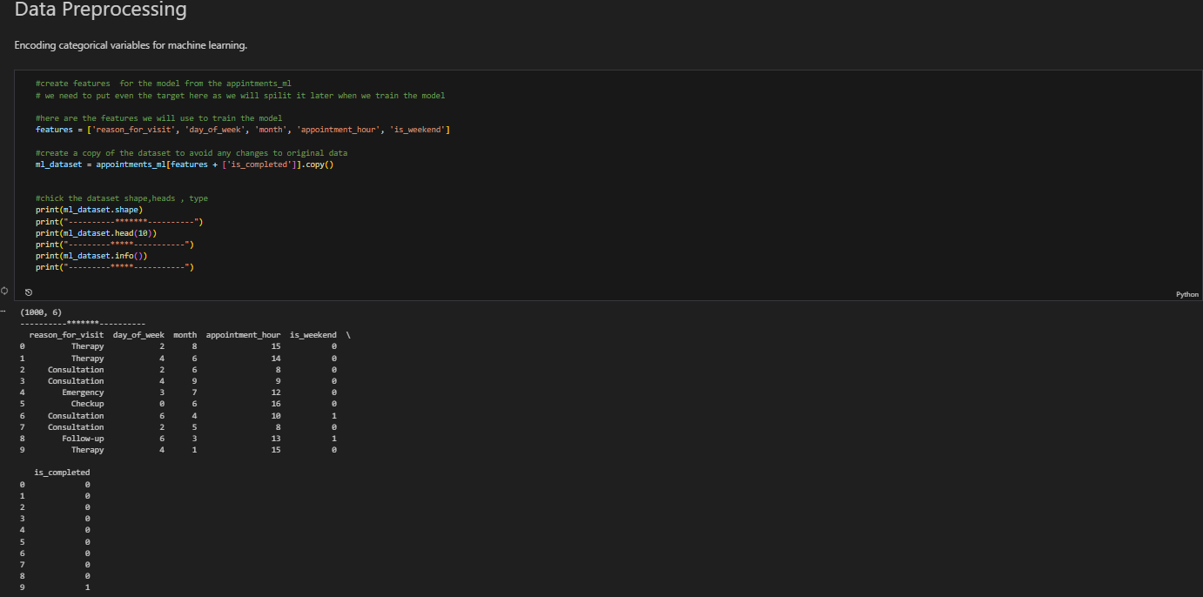
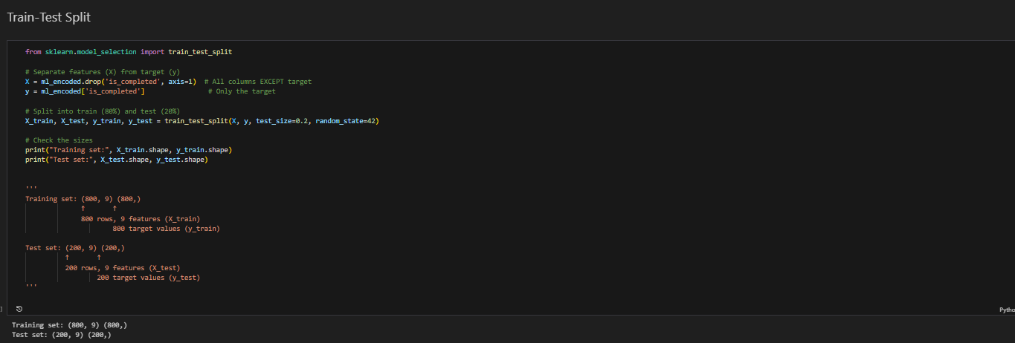
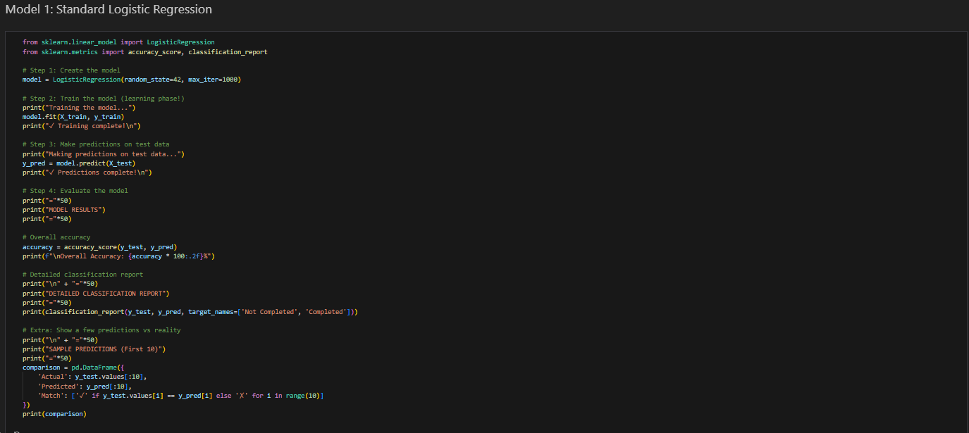
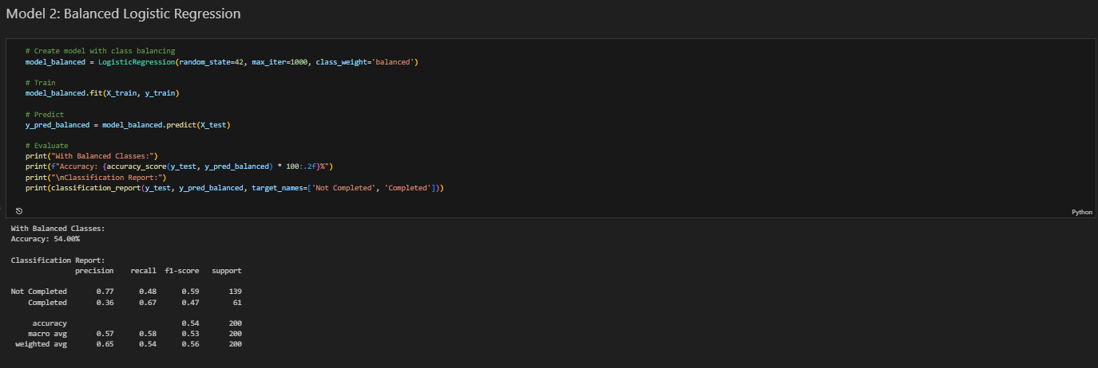
Machine learning

Slide 20
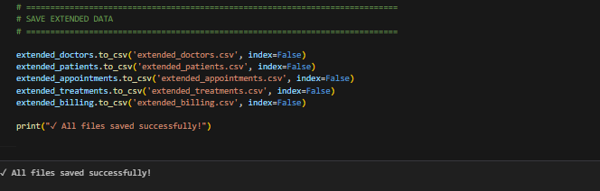
Machine learning

Slide 21
Machine learning

Slide 22
Machine learning

Slide 23
Machine learning

Slide 24
Machine learning

Slide 25
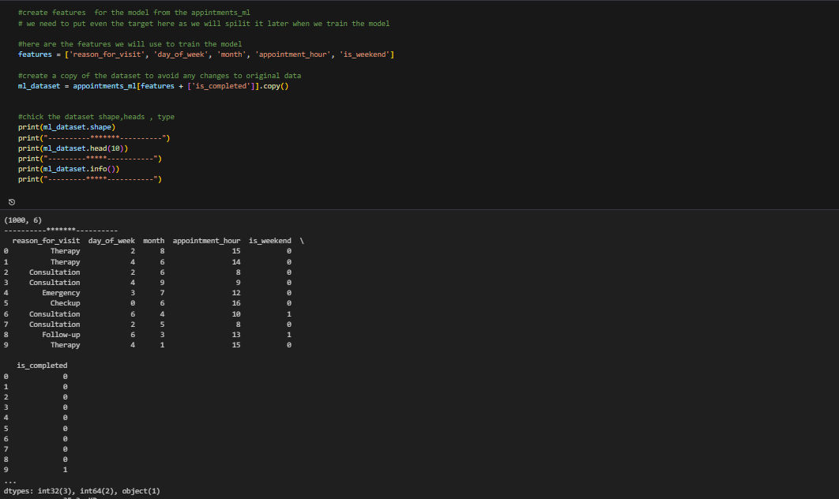
Machine learning

Slide 26
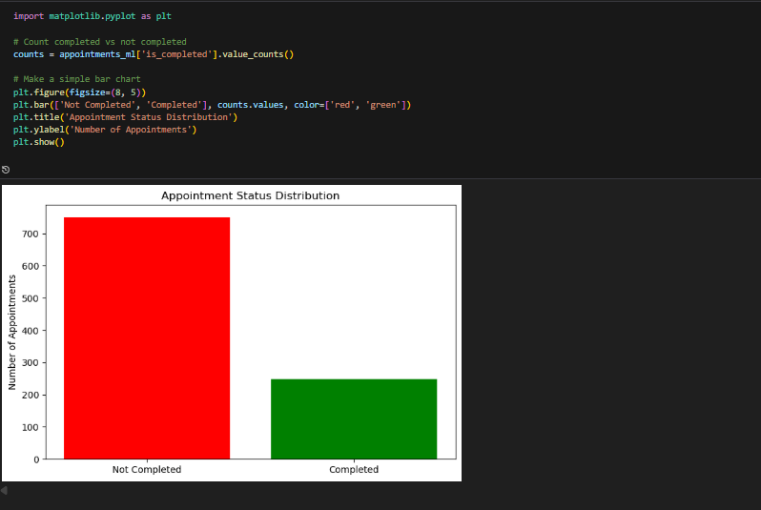
Machine learning

Slide 27
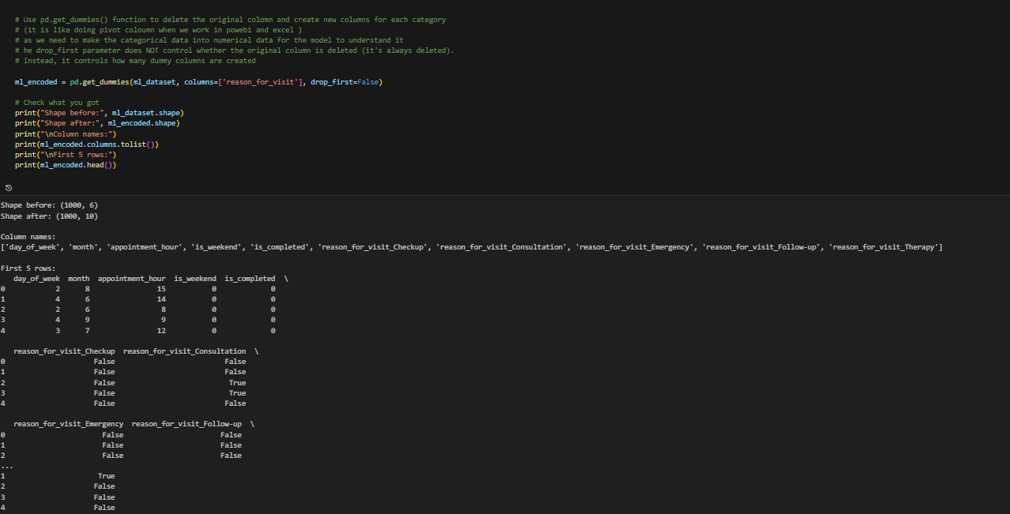
Machine learning

Slide 28
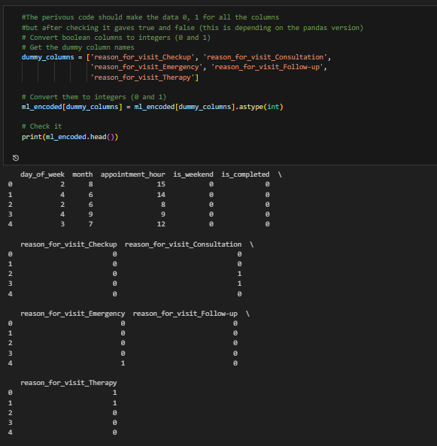
Machine learning

Slide 29
Machine learning

Slide 30
Machine learning

Slide 31
Machine learning

Slide 32
Machine learning

Slide 33

Recommendations
We recommend that future data collection is done in a proper and well-designed way, using correct sampling methods to avoid bias like the one found in the current dataset.

Slide 34







SCAN ME
Scan the QR and connect with us on LinkedIn
Notes:
33,87 cm
101,6 cm

